Slide 1


Introduction
Sun Tzu | Avalon Consulting
College Name | Team Name | Case
Indian Institute of Management, Lucknow | MV | Case 1: GreenGrow
Case 1 | GREENGROW | Round 1
Key Deliverables
Background
GreenGrow is into waste management and needs to set up RNG plants (6 being set up in Haryana and 11 in pipeline) across India.
The client desires the appropriate procurement strategy in order to:
Ensure that raw material collected fulfils annual volume requirements
Guarantee the quality of paddy straws to obtain maximum energy
Minimize expenditures and costs associated with procurement
Problem Definition
The plants run only on Paddy straws and hence the company wants to have a robust procurement strategy for the collection of Paddy straws.
Introduction
Industry Analysis
SC Analysis
Hypothesis
Surveying
Procurement
Transport & Logistics
Plant
Unit Econ
Future Prospects

Slide 2




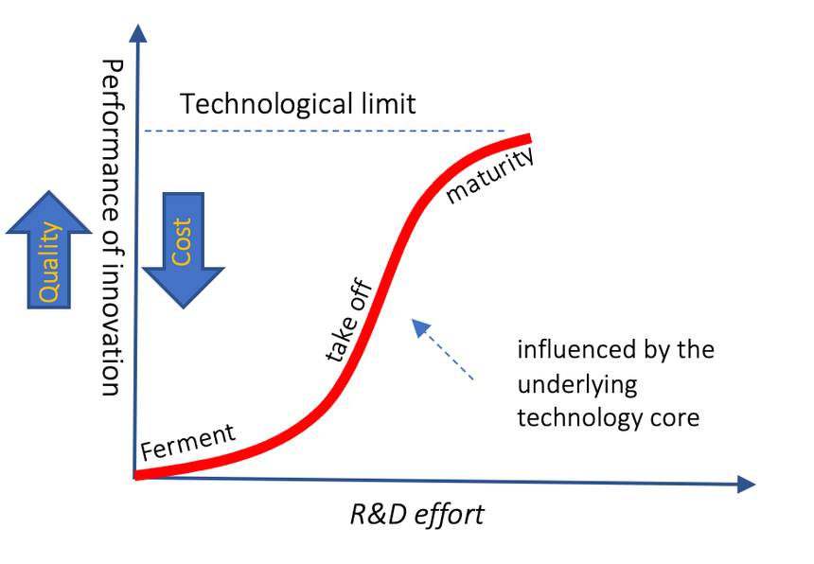


Industrial analysis reveals the high potential for stubble monetization, but short timelines is a concern.
POLITICAL
ECONOMIC
SOCIAL
TECHNOLOGY
LEGAL
ENVIRONMENT
Punjab Preservation of Subsoil Act (2009) – reduced time duration to 15-20 days
Penalty of Rs 2500/acre for stubble burning in Punjab and Haryana
States working on a plan to procure paddy straw at MSP
Growing energy and agriculture markets both will help RNG industry to grow with it.
Stubble burning leads to destruction of organic matters & creatures in fertile soil.
Paddy Crop failure via pest attack, fire, rain, or other natural causes
Organised bio-mass industry is leading to higher economic growth.
Burning of paddy being seen as a negative is growing in the masses
The growth in technology is quite slow with respect to other renewable energy technologies even though it is in nascent phase
Government schemes & subsidies of Rs. 40 Lakhs/MW (MAX 5 Crores per project)
Improved awareness among farmers regarding benefits of paddy straw.
PORTER’S FORCES (NEW ENTRANT PROSPECTIVE)
Laws & regulations increases the power of electricity corporations on RNG plants
Power of buyers is HIGH
Powerful govt. & private firms
Future stubble commoditization will boost supplier power
Power of Suppliers is MEDIUM
70%
Farmers attach no economic value to the stubble
Strong suppliers of rented logistical support
Technology is in fermentation phase of the S-curve, competing with many other technologies
Supplier could have alternative uses of stubble like organic fertilizer, paper mills etc.
Threat of substitute is HIGH
Competitive Rivalry is LOW
No single major player in the Industry
Global industry to grow with 6% CAGR, hence space for co-existing
163
11 & 10 plants in Punjab & Haryana respectively
RNG plants in India
Threat of new entrant is LOW
Rs. 4.5-5 Crore/MW capital required for setting up a new plant
No new plant was added in last year.
Biomass supply agreements between firm & source
JULY-AUGUST
Field visits & quality checks of the residue
SEPTEMBER
MID-OCTOBER
JUNE-JULY
MID-NOVEMBER
NOVEMBER TO NEXT CYCLE
Straw collection begins (just after paddy harvesting)
Awareness campaigns to avoid burning of residue
Straw collection ends (Spanning a period of 15-20 days)
Storing stubble in straw bank & utilizing for energy production
Timeline
Introduction
Industry Analysis
SC Analysis
Hypothesis
Surveying
Procurement
Transport & Logistics
Plant
Unit Econ
Future Prospects

Slide 3
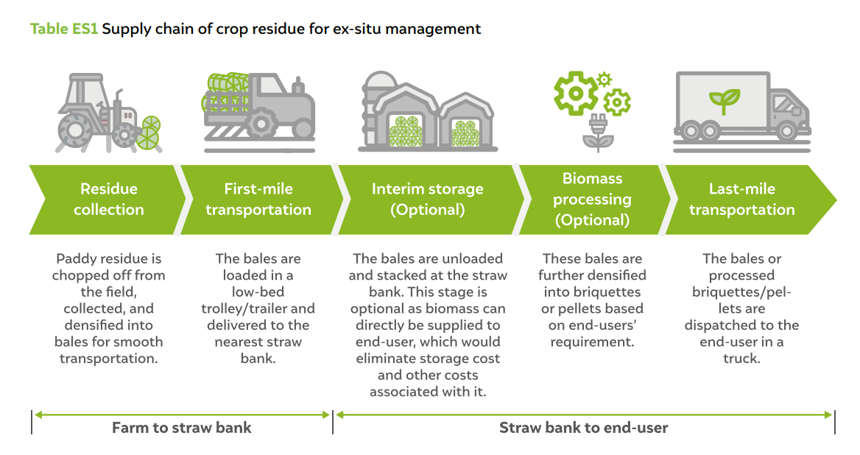




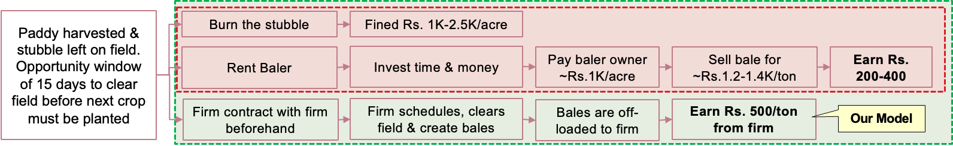
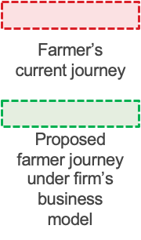
Optimized supply chain & gaining trust of farmers early is vital to the longetivity of business.
Supply Chain
First-mile transportation
Pre-Treatment Plant
Bio-mass to energy conversion
Residue collection
Storage unit
Surveying
Residue Collection
Transportation & Logistics
Pretreatment
Storage
Conversion
Awareness & Effective farmer communication
Channels
Route Optimization
Facility Location
Facility location for 11 plants
Facility Location
Sourcing Location​
Harvesting Schedule
Network Design for route optimization
Capacity Planning
Capacity Planning
Capacity Planning
Methods for survey participation​
Equipment Scheduling
Collection Centre Location
Methods for survey participation​
Scheduling
Technology Selection
Quality of Seeds, soil health, inputs used​
Vehicle Routing
Quality of Seeds, soil health, inputs used​
Maintenance & Operation
Farmer's Journey
Annexure for model analysis
Introduction
Industry Analysis
SC Analysis
Hypothesis
Surveying
Procurement
Transport & Logistics
Plant
Unit Econ
Future Prospects
Notes:
Collection of crop residue is a labour-intensive task and is a major cost in the crop residue supply chain.

Slide 4
Building hypothesis for ensuring robust procurement system
GreenGrow(‘GG’) can have robust and cost-effective procurement strategy for the paddy straws if
L1 – Builds network for residue collection
L1 – Build most effective procurement channel
L1 – Has optimized transportation system in place
L2 – GG can build its sourcing location for residue collection if
L2 – GG can have the right procurement channel if
L2 – GG can have optimized the transportation system if
GG build data-backed sources to pin-point location for procurement of high-quality paddy straws
Introduces a new incentive system for farmers for selling stubble
Build long term relationship with farmers/3rd party vendors for long term
Higher budget for procurement of paddy straws
GG build an optimal transportation system
GG has optimised the routing areas
Introduction
Industry Analysis
SC Analysis
Hypothesis
Surveying
Procurement
Transport & Logistics
Plant
Unit Econ
Future Prospects

Slide 5
While large farmers generate sufficient stubble, awareness among other farmers is key to remaining economically viable.
36.95 Million hectare under paddy cultivation (top 11 states)
Based on data by International Rice Research Institute: Stubble to Rice ratio is 0.7-1.4. Assumed to be 1.2 in this case.
EDUCATING FARMERS
Awareness factor | Sub-factors | Farmers (burning stubble)
Economic | Government side | Rs.1000-Rs.2500/Acre fine on burning residue Rs,1500-Rs.2500/Acre for using stubble management practices
 | Business side | Economic value of stubble if sold to service provider or RNG power plants
Ecological | Soil benefits | Micro-organisms and small creatures such as earthworms that enrich the soil Burning of stubble is harmful the soil
 | Urging to farmers conscience | Awareness regarding pollution and ecological impact of burning. Impact on energy crisis management
Personal Health |  | Fine particles penetrating deep into lungs
127.44 Million ton paddy stubble generated pan India
2.5488 MT is acquired by service providers
8.9208 MT retained by farmers
1.2744 MT acquired by paddy mills
Based on a study by ICAR, approximately 20% & 10% respectively is acquired by Service providers & paddy mills
4.46 tons in Haryana(4800 villages)
15.46 tons in Punjab
107.52 tons in Other states
Distance & transportation cost are the deciding factor
Marginal
(0.959 Mil ton)
Small (1.831 Mil ton)
Semi-Medium (5.064 Mil ton)
Medium (8.54 Mil ton)
Large (4.55 Mil ton)
BRAND INRODUCTION
General Awareness
Farmers' Engagement : Introduce the brand and build as a trustworthy and reliable partner.
Long-Term Partnership : Benefits of collaborating with our brand, stable income, environmental impact, and mutual growth.
Demonstration Farms: Set up model farms where stubble utilization is showcased to inspire farmers.
Village Meetings: Organize gatherings where experts can interact with farmers and address their concerns about stubble burning
Fragmented land holding making procurement costly and inefficient
Larger land holdings. Potential targets for procurement
1 RNG plant needs 200000 ton/year;
6 plants = 1.2 million ton/year
Total required stubble is 27% of Stubble available with large farmers.
Based on benchmarking with ‘M/s. Sukhbir Agro Energy Limited’, one of the RNG plants in Punjab
35 million tonnes paddy straw are burnt in Punjab and Haryana alone making brand and awareness approaches extremely important
Introduction
Industry Analysis
SC Analysis
Hypothesis
Surveying
Procurement
Transport & Logistics
Plant
Unit Econ
Future Prospects

Slide 6
Procurement should focus on Superior Channels in the short term, while exploring other optimal options.
Farmers
Service Providers
Govt. Agency & Online Mkt.
Paddy Mills
Procurement Channels
1.Direct Procurement: Farmer creates & supplies bales
2.Field Clearing Services: Firm provides machinery & labour to clear field
1.Tender Bidding by 3P stubble aggregators/baler owners
2.Farmer Co-op contracted to aggregate feedstock 3.Micropreneurs network built to collect stubble
1.Mandi & E-procurement system utilized to collect & sell stubble
2. Online Platform (individual or in collaboration) similar to other Agri-product procurement like E-Naam, Agri Bazar
1. Paddy Straw is an unused residue, which can be collected & brough to use.
Direct
Procurement: Farmers earn Rs. 200-300/acre
Field Clearing Svc: Farmers earn Rs. 500/acre
Issue: Tender Bidding requires thorough evaluation of svc provider
Issue: Farmer Co-op & Micropreneur network have longer execution horizons
Issue: For Mandi, MSP proposed but not enforced. Dependent on commoditization of stubble
Issue: Online Platform requires significant investment & has longer horizon
Issue: The stubble of mechanically
harvested paddy remains on field & thus may not be viable.
Issue: Manually harvested paddy may have stubble but is expensive to carry out
Focus on large farmers as superior channel
Burning stubble is preferred
With 3P service, the problem would be to negotiate for optimal terms – direct procurement problems is off-loaded
Procurement Problem
Problem Detailing
Proposed Solutions
Procuring through farmers
Forest Harvest Scheduling Problem
Maximize harvesting profit while prohibiting harvesting of contiguous areas larger than a specified value
Heuristic Approach: Prioritize harvesting areas based on their profitability and adjacency, targeting farmers with contiguous areas of more than 10 acres
Crop Harvesting Problem
Need to maximize profit with limited time window and resource constraints of equipment and labor
Greedy algorithm that selects fields for harvesting in a sequence maximizing profit while adhering to time and resource constraints.
Scheduling Problem for Equipment
Scheduling problem for arranging equipment for harvesting to minimize the total operational costs
Genetic algorithms for scheduling equipment allocation. distance between fields, equipment availability. Partnering up with 3P providers for balers & rent balers from baler owners
Introduction
Industry Analysis
SC Analysis
Hypothesis
Surveying
Procurement
Transport & Logistics
Plant
Unit Econ
Future Prospects

Slide 7
Short distance transportation & robust storage solutions are crucial to current business model.
Transport
Logistics
To minimize distance traversed & enhance collection schedule for maximum collection efficiency in a short window, route optimization is required.
Pre-Transportation Checks
Stubble should be transported in the baled form, which helps in efficient transportation & handling
Quality parameters for stubble procurement of should be announced openly to farmers, motivators & liaison agencies.
Route Choice
Dynamic Vehicle Routing Problem: Plans routes by minimizing distance & adapts to changing conditions
Multi-Objective Route Optimization: Optimizes routes considering multiple objectives
Pre-Transportation Treatment
The thrashed straw should be stored in clean spaces so that it does not carry any undesired material from the ground.
It should be covered to protect from rain and dust storms, thus ensuring lower moisture & dust content in the stubble.
Iterated Local Search: Apply local search heuristics to improve current solution as new areas are added
Transport of Stubble
Long-Term Storage
Truck
Train
Others
Quality Control
Required at both starting & end – sanity checks must be conducted to ensure that collected straw meets all quality parameters for efficient power generation.
Cost/KM for 1Ton = Rs. 1.1
Cost/KM for 18MW plant’s material = Rs. 2.3 Lakh
Cost/KM for 1Ton = Rs. 0.8
Cost/KM for 18MW plant’s material = Rs. 1.7 Lakh
Trolley likely to have lower load capacity, making it more expensive than Truck
Network Transport Analysis
Storage & Preservation
Pre-investigate strategies for storing excess feedstock during peak seasons:
Superiority of the warehouse and optimal sanitary conditions for operations
Oxidization of stubble to improve the GCV value & reduce volume for storage
Storage Space
Due to seasonal availability & bulkiness, large & enclosed storage space is needed. Storage in open can result in decay of ~20% stubble.
Suitable fire protection arrangements must be made in the stockyard, with well laid-out water pipelines and provision for rubber hoses.
The straw should preferably be stored on the raised platforms, so that it can be saved from water logging and microbial attacks from the ground.
Cost for short dist. (<50KM) = ~Rs. 1.15Cr
Cost for long dist. (<100KM) = Rs. 1.7Cr+
Due to high cost, animal cart is not considered.
Transportation over greater distances is expensive, making sourcing only from same/neighbouring states economically feasible. Thus, plants should be constructed in paddy regions
Labour Requirement
Labour intensive process - labour could be contracted or employed.
Numerous factories are constrained on this front by political interference and stringent labour regulations.
Annexure for Assumptions
Introduction
Industry Analysis
SC Analysis
Hypothesis
Surveying
Procurement
Transport & Logistics
Plant
Unit Econ
Future Prospects
Notes:
Determine the plant's storage capacity for both in-season and off-season feedstock.
Develop a storage strategy that prevents degradation of feedstock quality and minimizes losses due to weather or pests.
Design storage facilities that protect feedstock from moisture, fire, and other environmental factors.

Slide 8
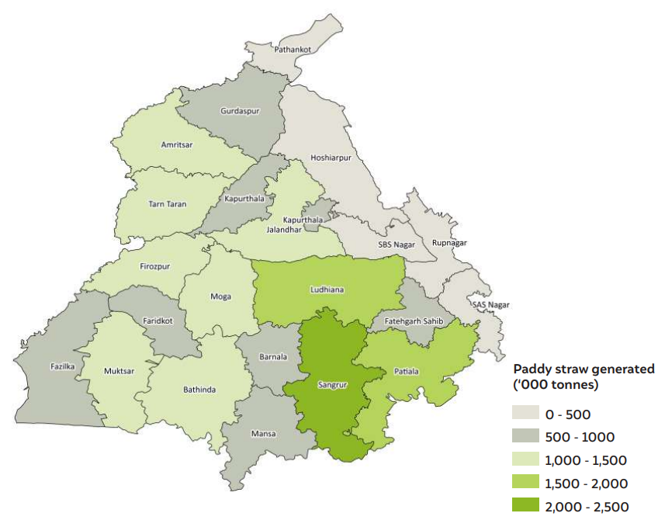
New plants should be set-up in areas with high paddy availability & minimal overlap with existing plants.
PLANT REQUIREMENTS
Proposal for setting up future RNG Plants
Optimal Plant Size
Ideal plant capacity based on feedstock availability and power demand. Balance between economies of scale and operational efficiency.
Proposal for setting up 5 new plants in the Punjab region
Hypothesis:
Setting up the plant such that there is minimal overlap in the region in the 50 km radius of the plant.
Choosing regions with the highest volume of paddy straw generated and no plants.
Technology Selection
Automation of the energy conversion process
Choose advanced and efficient RNG plant technology to maximize power generation from the feedstock.
integration with the energy grid.
Maintenance
Implement regular maintenance schedule for plant equipment & machinery to ensure continuous efficiency & prevent breakdowns.
Maintain an inventory of critical spare parts to promptly address any unforeseen equipment failures.
District wise paddy straw generated in Punjab
Labour
Ensure the availability of skilled personnel who can troubleshoot and manage any technical issues.
Location of current RNG plants (11 in Punjab)
Suggested location for plant set-up in Punjab
163 total no. of Biomass power plants in India
Annual Energy Cost Savings of Rs. 787 lakh
Annual Bio-Manure Production of 32582 tons
63438 (Direct) & 56894 (In-direct) Man-hour employed
Annual CO2 saving of 9587 tons
Our plants will contribute towards these positives. The impact will depend on the size of the plant and some other related variables
Locations are approximated with district only*
Introduction
Industry Analysis
SC Analysis
Hypothesis
Surveying
Procurement
Transport & Logistics
Plant
Unit Econ
Future Prospects

Slide 9





Economic Unit Value is crucial for profit estimation & model optimization.
1
Revenue
2
Units of electricity generated by 1MW plant in 18H | 18K units/day
Units of electricity generated by 6 18MW plant (18H day, 90% of year) | 64Cr units/yr
Punjab State Power Corp. Tariff | Rs. 4/unit
Revenue generated | Rs. 255 Cr/yr
Stubble generated in Punjab & Haryana | 1.8Cr Ton/yr
Stubble for 6 18MW plant | 1200K Ton/yr
Payment to Farmers @Rs.500/ton | Rs. 60 Cr/yr
COGS
4
Area under Paddy to be baled | 261K Hectare
Days required to bale (12H day @80% efficiency) | 240K Hours
No. of balers required to complete in 15 days | 1660
Cost of Balers @Rs. 14 Lakh | Rs. 233 Cr
Cost of Tractor @Rs. 9 Lakh | Rs. 150 Cr
Cost of Diesel | Rs. 65 Cr
Cost of Labour – 3 pax/baler | Rs. 3 Cr
3
Transport
Cost/KM for 1Ton via Truck | Rs. 1.1
Cost for stubble for 6 18MW plants for 50KM | Rs. 7Cr
5
Procurement
Gross Calorific Value (GCV): Should be >3500kCal. Analysis of the impact of seed quality, farming techniques, & field quality on GCV needed
Moisture: Should be <10-15% to prevent paying for equipment damage and water weight
Dust, Straw Density: Determine acceptable ranges for these parameters in the feedstock.
Soil Health & Crop Nutrition: Soil health affects plant nutrition; Nutrient-rich soil enhances growth, affecting GCV in crops
Cumulative
Detailed Analysis
Quality
Parameters
Total Revenue | Total Cost | Total Profit
Rs. 255 Cr | Rs. 227 Cr | Rs. 28 Cr
Introduction
Industry Analysis
SC Analysis
Hypothesis
Surveying
Procurement
Transport & Logistics
Plant
Unit Econ
Future Prospects

Slide 10
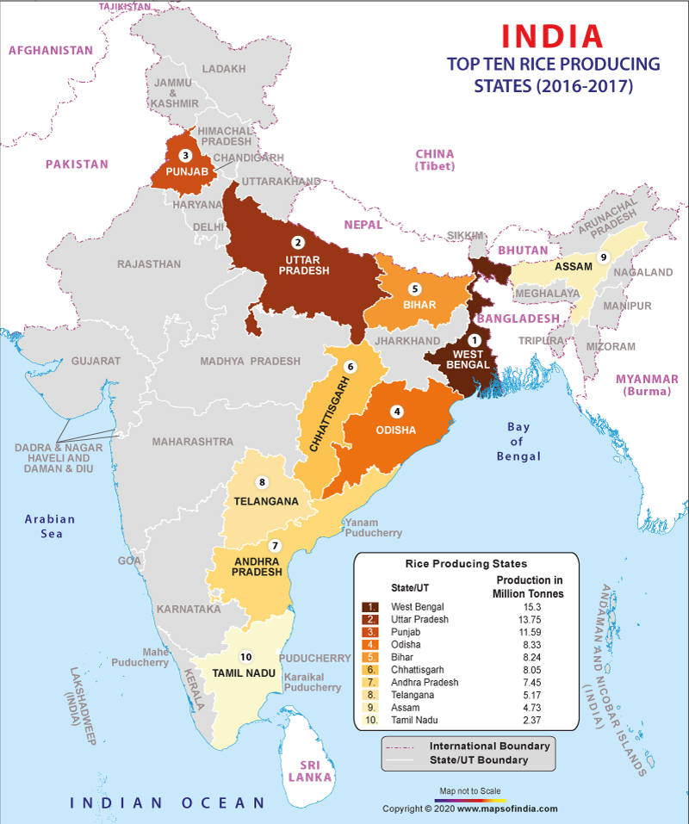
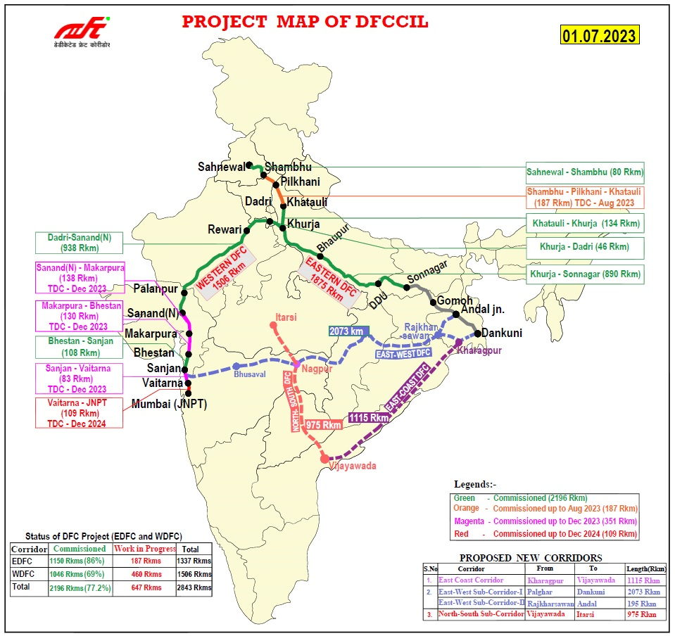
Thank You!
Superior solutions of the future will drive the market, improving production in India.
Surveying
Procurement
Market Alignment
Collecting accurate & timely data by drones can aid in monitoring paddy's health and harvest readiness, benefiting both the firm and the farmer.
Drones can also be utilised for effective planning during the brief window of opportunity & widen the network of farms from which residue is sourced.
Govt. Agency: Enforcement of MSP could facilitate appropriate trading channels for stubble and increase farmers' compensation.
Straw Banks & E-Commerce: A dense network of Straw Banks & online trading can further help in expansion of micropreneurs & farmer co-ops.
Diversification: The company should also evaluate utilising other bio-residues in case of unforeseen circumstances such as crop failure, rain, fire, etc.
Technology: If bale sizes are standardized, the cutters and other handing equipment installed in the mills will be accordingly standardized.
Team Details
Jay Kumar PGP38069@IIML.AC.IN +91 98970 63440
Kritika Prakash PGP38347@IIML.AC.IN +91 98719 31051
Shivam Pathak ABM19021@IIML.AC.IN +91 80738 00369
Transport
Improvements due to govt. schemes: Gati Shakti & Dedicated Freight Corridors for multi-modal connectivity for high-speed & seamless connectivity.
DFC can help connect to more paddy-focused states & establish plants while minimizing costs.
Eastern DFC & East-Cost DFC will establish connections among the top paddy-producing states, leading to formation of a resilient & efficient supply chain network.
Introduction
Industry Analysis
SC Analysis
Hypothesis
Surveying
Procurement
Transport & Logistics
Plant
Unit Econ
Future Prospects

Slide 11
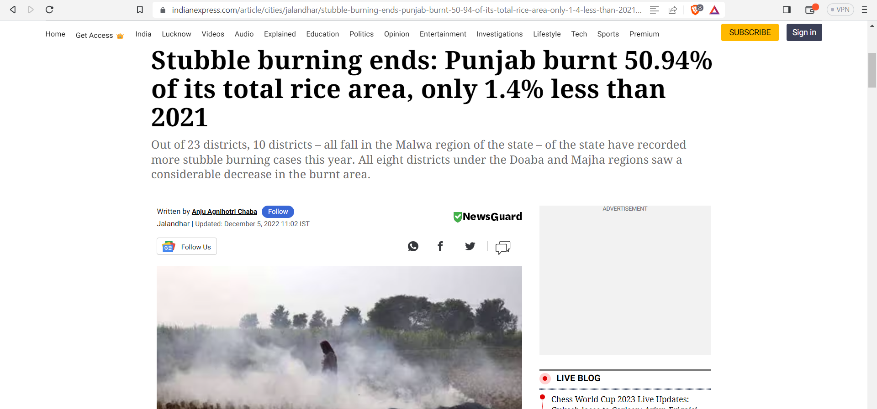
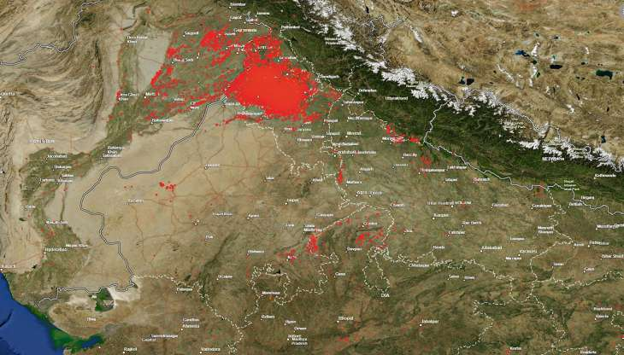
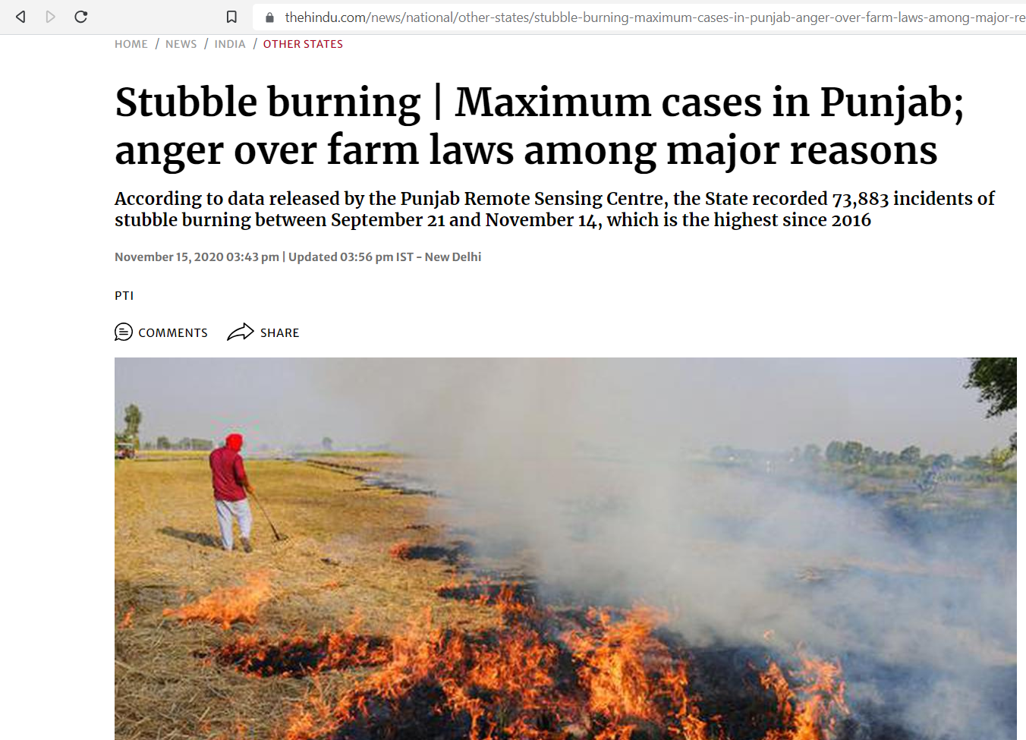
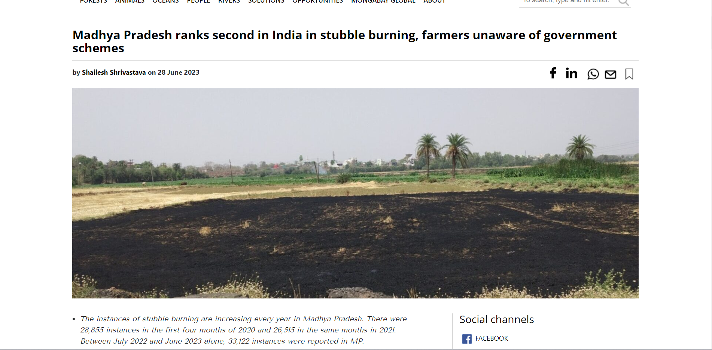
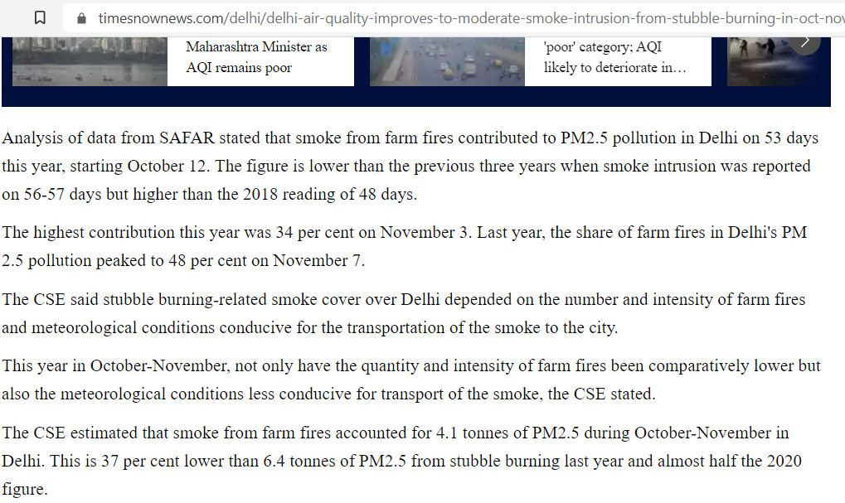
Annexure 1 : News articles capturing the impact of stubble burning
NASA images show red dots that indicate fires, including stubble burning surrounding Delhi and other neighboring states.

Slide 12
Annexure 2 : Paddy Stubble Type Analysis
State | Area Under Paddy Cultivation (Million Ha) | Paddy Yield (Kg/Ha) | Production | Stubble (Mt) (S/P=1.2)
West Bengal | 5.6 | 2996 | 16777.6 | 20.13
Uttar Pradesh | 5.7 | 2679 | 15270.3 | 18.32
Punjab | 2.97 | 4340 | 12889.8 | 15.46
Telangana | 3.65 | 3366 | 12285.9 | 14.74
Odisha | 3.94 | 2318 | 9132.92 | 10.95
Tamil Nadu | 2.21 | 3658 | 8084.18 | 9.71
Chhattisgarh | 3.76 | 2101 | 7899.76 | 9.48
Andhra Pradesh | 2.25 | 3470 | 7807.5 | 9.37
Bihar | 3.1 | 2282 | 7074.2 | 8.49
Assam | 2.36 | 2236 | 5276.96 | 6.33
Haryana | 1.41 | 3236.02 | 4562.8 | 4.46
Total | 36.95 | 32682.02 | 107061.9 | 127.44
Source: Agricultural Statistics at a Glance, 2021, Ministry of Agriculture and Farmers Welfare, Government of India.
Source: International Rice research Institute

Slide 13
Annexure 3 : Business Model Analysis
Case 1: Balers are bought & farmers are provided field clearing service but are not paid
Case 2: Balers are rented, farmers are provided field clearing service but are not paid
Head | Explanation | Amount (Rs.)
Revenue | For 6 18MW plants | 2,554,416,000
Cost of Baler | Amortization over 15Yr | 155,555,556
Cost of Tractor | Amortization over 15Yr | 100,000,000
Cost of Diesel | Estimated as Rs.1K, considering the Baler rent per acre | 646,484,632
Cost of Labour | 3 semi-skilled labourer required for each | 30,975,000
Cost of Farmer Payment | Rs. 0/ton paid to Farmer | 0
Cost of Transportation to Plant | Assumed 50KM distance | 68,693,980
Maintenance Cost for Truck & Baler | Assumed @20% of cost over lifetime | 466,666,667
Overheads | Assumed @10% | 146,837,583
Total P/L |  | 939,202,583
Head | Explanation | Amount (Rs.)
Revenue | For 6 18MW plants | 2,554,416,000
Rent of Baler |  | 969,726,948
Cost of Tractor | Amortization over 15Yr | 0
Cost of Diesel | Estimated as Rs.1K, considering the Baler rent per acre | 0
Cost of Labour | 3 semi-skilled labourer required for each | 30,975,000
Cost of Farmer Payment | Rs. 0/ton paid to Farmer | 0
Cost of Transportation to Plant | Assumed 50KM distance | 68,693,980
Maintenance Cost for Truck & Baler | Assumed @20% of cost over lifetime | 0
Overheads | Assumed @10% | 106,939,593
Total P/L |  | 1,378,080,479
Insight: While the model generates high profits (Rs. 93Cr), this is not feasible for the long term. Once bale gets commoditized, the farmer may no longer be willing to give bales for free, despite the services offered.
Insight: While the model generates highest profits (Rs. 137Cr), it is not sustainable in the long run because it creates equipment dependence on third parties. Baler Renters can capitalize on such an opportunity & can create problems for the firm.

Slide 14
Annexure 3 : Business Model Analysis
Case 3: Balers are bought & farmers are provided field clearing service & are paid for the bales
Detailed Analysis
Head | Explanation | Amount (Rs.)
Revenue | For 6 18MW plants | 2,554,416,000
Cost of Baler | Amortization over 15Yr | 155,555,556
Cost of Tractor | Amortization over 15Yr | 100,000,000
Cost of Diesel | Estimated as Rs.1K, considering the Baler rent per acre | 646,484,632
Cost of Labour | 3 semi-skilled labourer required for each | 30,975,000
Cost of Farmer Payment | Rs. 500/ton paid to Farmer | 600,000,000
Cost of Transportation to Plant | Assumed 50KM distance | 68,693,980
Maintenance Cost for Truck & Baler | Assumed @20% of cost over lifetime | 466,666,667
Overheads | Assumed @10% | 206,837,583
Total P/L |  | 279,202,583
Insight: While this model generates the lowest profits (Rs. 28Cr), it is the most sustainable in the long run. Before stubble is commoditized, this presents an opportunity to establish long-term relationships with farmers and gain their trust. This will enable the company to maintain long-lasting relationships with the producers despite the changing market environment. Furthermore, since the equipment is possessed, there is no dependence on third-party providers.

Slide 15
Annexure 4 : Key Questions & Assumptions of Model
Key Concern Areas
Key Questions
Detailed Assumption
Assumptions of Model
Surveying
What is the brand value & market foothold of firm?
What is the existing network that can be used to generate trust & gather info?
Power Plant
Power Rating: All 6 power plants are assumed to be 18MW
Raw Material: Each 18MW is assumed to consumer 200K Ton of stubble per year (basis SAEL, Punjab)
Operational Hours: Power plant assumed to be operational for 18H/day, 90% of the year
Tariff Rate: Electricity unit's selling rate assumed to be Rs. 4 (basis the tariff of Punjab State Power Corp. Ltd.)
Procurement
What is the number of balers available for renting in the region?
What's the dependence on rented balers?
Are there farmer co-operatives that can be leveraged to collect bales and what are the common methods of incentivisation?
Transportation
What % of the budget is generally allocated to transportation & logistics in the industry?
What is the tech currently used for route optimization & have other options been considered?
Procurement Equipment
Baler: Assumed to cost Rs. 14L with life of 15 years
Tractor: Assumed to cost Rs. 9L with life of 15 years
Labour: Assumed that each machine requires 1 person + 2 assistants (Semi-Skilled), paid Rs. 413/day (basis Haryana Labour Wage)
Diesel: Assumed to cost Rs. 1K/acre, considering the baler rent costs of Rs. 1-1.5K/acre
Storage
How is the quality check of bales carried out on field (moisture content, GCV value, etc.) & at the warehouse?
Are there any existing warehouse that can be utilized to create straw banks for the company?
Plant
What is the capacity (MW) of the firm's plants (current & future)?
What is the expected operational hours & days for the plant?
How many employees are generally required at the plant?
Transportation
Partnerships
What kind of long-term agreements or partnerships are you open to, in order to secure a steady feedstock supply?
Are there any plans to explore alternative sources of feedstock beyond paddy straw to ensure a more resilient supply chain?
Business model pivots on other materials like fertilizers etc?
Freight Cost by Train: Assumed to be Rs. 0.8/KM for 1Ton (basis freight rates of Indian Railways)
Freight Cost by Truck: Assumed to be Rs. 1.1/KM for 1Ton (basis news article)

Slide 16
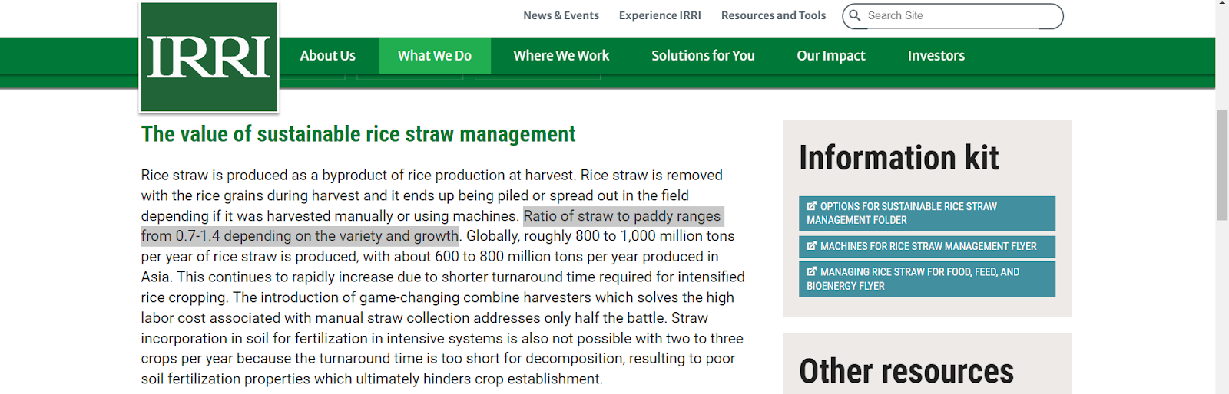
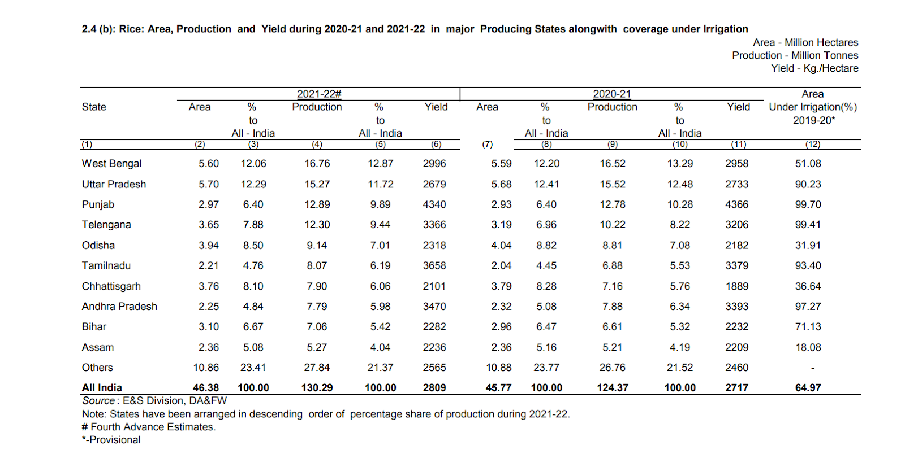
Annexure 5 : REFERENCES
https://mnre.gov.in/bio-energy/current-status
https://www.ceew.in/sites/default/files/CEEW-Ex-situ-Crop-Residue-Management-24Dec20_0.pdf
https://www.irri.org/rice-straw-management
https://www.peda.gov.in/biomass-power-projects
https://icar.org.in/sites/default/files/2022-09/ICAR-AR-21-22%E2%80%93E.pdf (ICAR annual report)
Agricultural Statistics at a Glance, 2021, Ministry of Agriculture and Farmers Welfare, Government of India.

